Slide 1
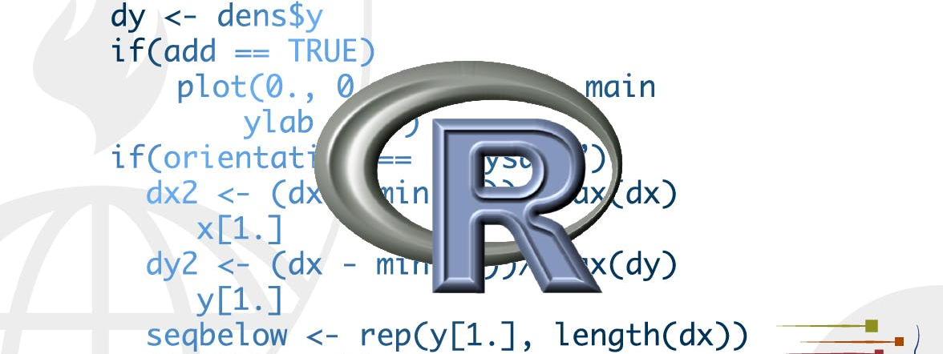
factors
STA 4233 Introduction to Programming and Data Management in R
Notes:
In R, factors are used to work with categorical variables, variables that have a fixed and known set of possible values. They are also useful when you want to display character vectors in a non-alphabetical order.
Historically, factors were much easier to work with than characters. As a result, many of the functions in base R automatically convert characters to factors. This means that factors often crop up in places where they’re not actually helpful. Fortunately, you don’t need to worry about that in the tidyverse, and can focus on situations where factors are genuinely useful.

Slide 2

The forcats package
Notes:
To work with factors, we’ll use the forcats package, which is part of the core tidyverse. It provides tools for dealing with categorical variables (and it’s an anagram of factors!) using a wide range of helpers for working with factors.

Slide 3
Learning more
Amelia McNamara and Nicholas Horton’s paper, Wrangling categorical data in R.
stringsAsFactors: An unauthorized biography
stringsAsFactors = <sigh>
Notes:
If you want to learn more about factors, I recommend reading Amelia McNamara and Nicholas Horton’s paper, Wrangling categorical data in R. This paper lays out some of the history discussed in stringsAsFactors: An unauthorized biography and stringsAsFactors = <sigh>, and compares the tidy approaches to categorical data outlined in this course with base R methods. An early version of the paper help motivate and scope the forcats package; thanks Amelia & Nick!

Slide 4
Creating factors
x1 <- c("Dec", "Apr", "Jan", "Mar")
x2 <- c("Dec", "Apr", "Jam", "Mar")
sort(x1) #> [1] "Apr" "Dec" "Jan" "Mar"
Notes:
Imagine that you have a variable that records month
Using a string to record this variable has two problems:
There are only twelve possible months, and there’s nothing saving you from typos:
It doesn’t sort in a useful way:

Slide 5
Creating factors
month_levels <- c(
"Jan", "Feb", "Mar", "Apr", "May", "Jun",
"Jul", "Aug", "Sep", "Oct", "Nov", "Dec"
)
y1 <- factor(x1, levels = month_levels)
y1
#> [1] Dec Apr Jan Mar
#> Levels: Jan Feb Mar Apr May Jun Jul Aug Sep Oct Nov Dec
sort(y1)
#> [1] Jan Mar Apr Dec
#> Levels: Jan Feb Mar Apr May Jun Jul Aug Sep Oct Nov Dec
Notes:
You can fix both of these problems with a factor. To create a factor you must start by creating a list of the valid levels:
Now you can create a factor:

Slide 6
Creating factors
y2 <- factor(x2, levels = month_levels)
y2
#> [1] Dec Apr <NA> Mar
#> Levels: Jan Feb Mar Apr May Jun Jul Aug Sep Oct Nov Dec
y2 <- parse_factor(x2, levels = month_levels)
#> Warning: 1 parsing failure.
#> row col expected actual
#> 3 -- value in level set Jam
Notes:
And any values not in the set will be silently converted to NA:
If you want a warning, you can use readr::parse_factor():

Slide 7
Creating factors
factor(x1)
#> [1] Dec Apr Jan Mar
#> Levels: Apr Dec Jan Mar
f1 <- factor(x1, levels = unique(x1))
f1
#> [1] Dec Apr Jan Mar
#> Levels: Dec Apr Jan Mar
f2 <- x1 %>% factor() %>% fct_inorder()
f2
#> [1] Dec Apr Jan Mar
#> Levels: Dec Apr Jan Mar
Notes:
If you omit the levels, they’ll be taken from the data in alphabetical order:
Sometimes you’d prefer that the order of the levels match the order of the first appearance in the data. You can do that when creating the factor by setting levels to unique(x), or after the fact, with fct_inorder():

Slide 8
Levels()
levels(f2)
#> [1] "Dec" "Apr" "Jan" "Mar"
Notes:
If you ever need to access the set of valid levels directly, you can do so with levels(): STOP

Slide 9

General Social Survey
http://gss.norc.org/
Notes:
For the rest of this chapter, we’re going to focus on forcats::gss_cat. It’s a sample of data from the General Social Survey, which is a long-running US survey conducted by the independent research organization NORC at the University of Chicago.

Slide 10
Gss_cat
gss_cat
#> # A tibble: 21,483 x 9
#> year marital age race rincome partyid relig denom tvhours
#> <int> <fct> <int> <fct> <fct> <fct> <fct> <fct> <int>
#> 1 2000 Never mar… 26 White $8000 to … Ind,near r… Protesta… Souther… 12
#> 2 2000 Divorced 48 White $8000 to … Not str re… Protesta… Baptist… NA
#> 3 2000 Widowed 67 White Not appli… Independent Protesta… No deno… 2
#> 4 2000 Never mar… 39 White Not appli… Ind,near r… Orthodox… Not app… 4
#> 5 2000 Divorced 25 White Not appli… Not str de… None Not app… 1
#> 6 2000 Married 25 White $20000 - … Strong dem… Protesta… Souther… NA
#> # … with 2.148e+04 more rows
?gss_cat
Notes:
The survey has thousands of questions, so in gss_cat I’ve selected a handful that will illustrate some common challenges you’ll encounter when working with factors.
(Remember, since this dataset is provided by a package, you can get more information about the variables with ?gss_cat.)

Slide 11
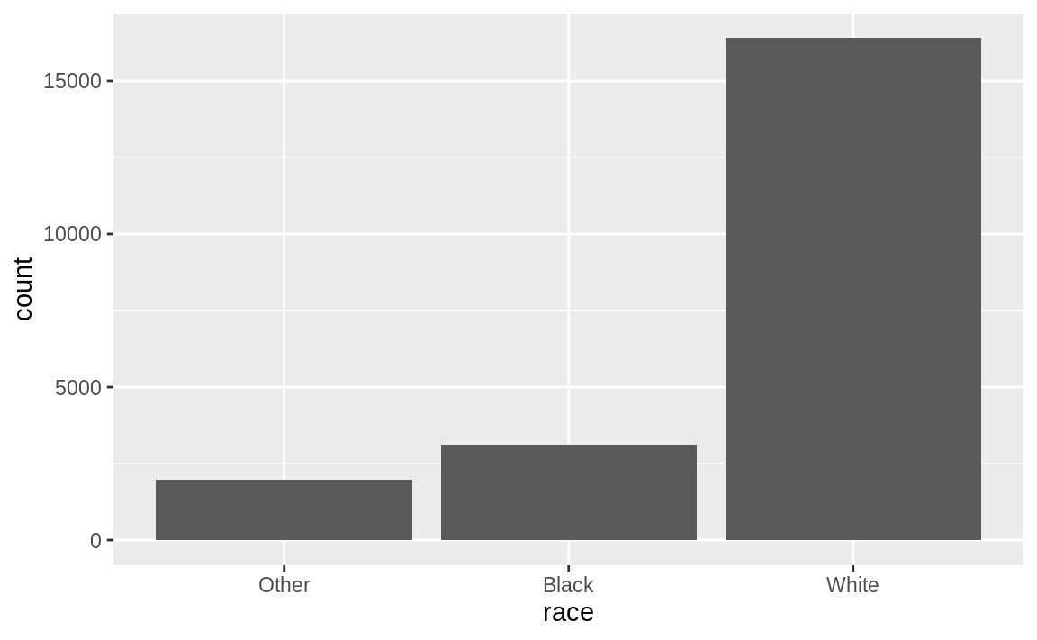
Levels in a tibble
gss_cat %>%
count(race)
#> # A tibble: 3 x 2
#> race n
#> <fct> <int>
#> 1 Other 1959
#> 2 Black 3129
#> 3 White 16395
ggplot(gss_cat, aes(race)) +
geom_bar()
Notes:
When factors are stored in a tibble, you can’t see their levels so easily. One way to see them is with count():

Slide 12
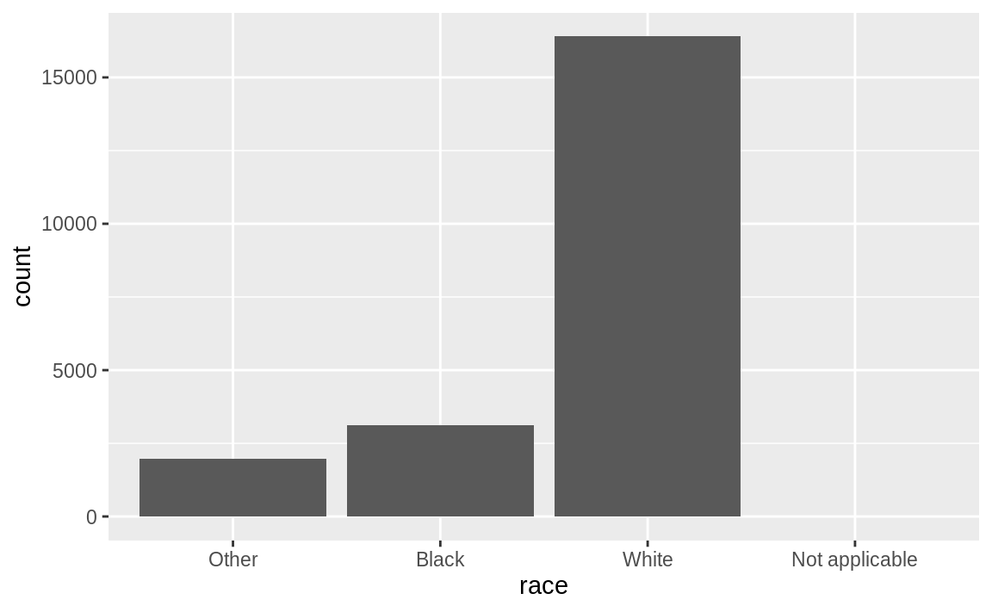
Levels with no values
ggplot(gss_cat, aes(race)) +
geom_bar() +
scale_x_discrete(drop = FALSE)
Notes:
By default, ggplot2 will drop levels that don’t have any values. You can force them to display with:
These levels represent valid values that simply did not occur in this dataset. Unfortunately, dplyr doesn’t yet have a drop option, but it will in the future.
When working with factors, the two most common operations are changing the order of the levels, and changing the values of the levels. Those operations are described in the sections below.

Slide 13
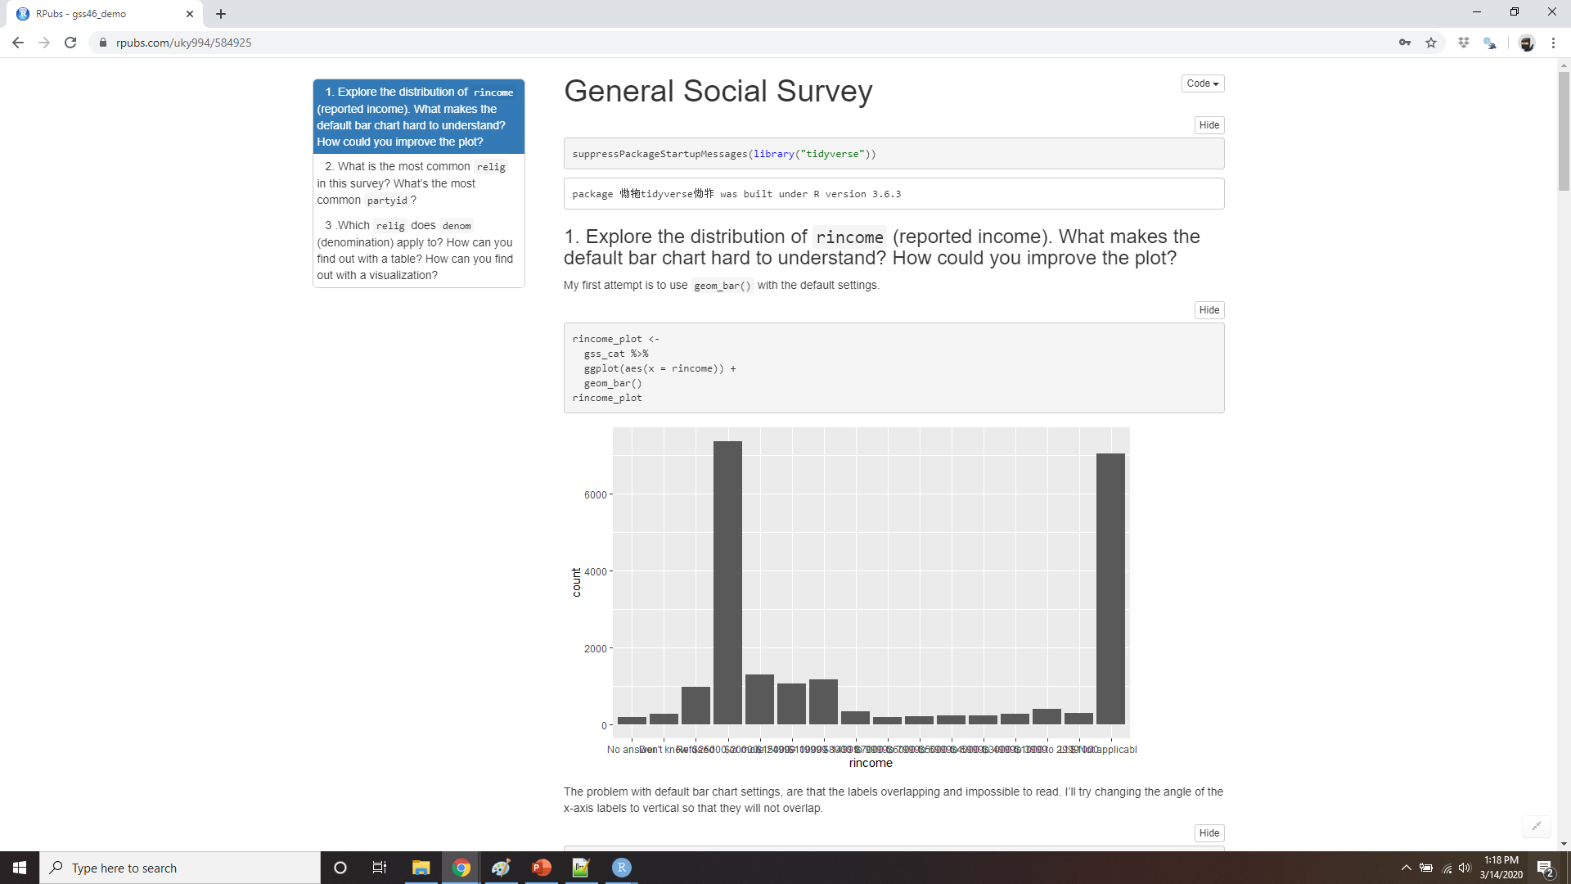
Demo general social survey
Notes:
https://rpubs.com/uky994/584925
Explore the distribution of rincome (reported income). What makes the default bar chart hard to understand? How could you improve the plot?
What is the most common relig in this survey? What’s the most common partyid?
Which relig does denom (denomination) apply to? How can you find out with a table? How can you find out with a visualisation?

Slide 14
Modifying factor order
relig_summary <- gss_cat %>%
group_by(relig) %>%
summarise(
age = mean(age, na.rm = TRUE),
tvhours = mean(tvhours, na.rm = TRUE),
n = n() )
ggplot(relig_summary, aes(tvhours, relig)) +
geom_point()
Notes:
It’s often useful to change the order of the factor levels in a visualisation. For example, imagine you want to explore the average number of hours spent watching TV per day across religions:

Slide 15
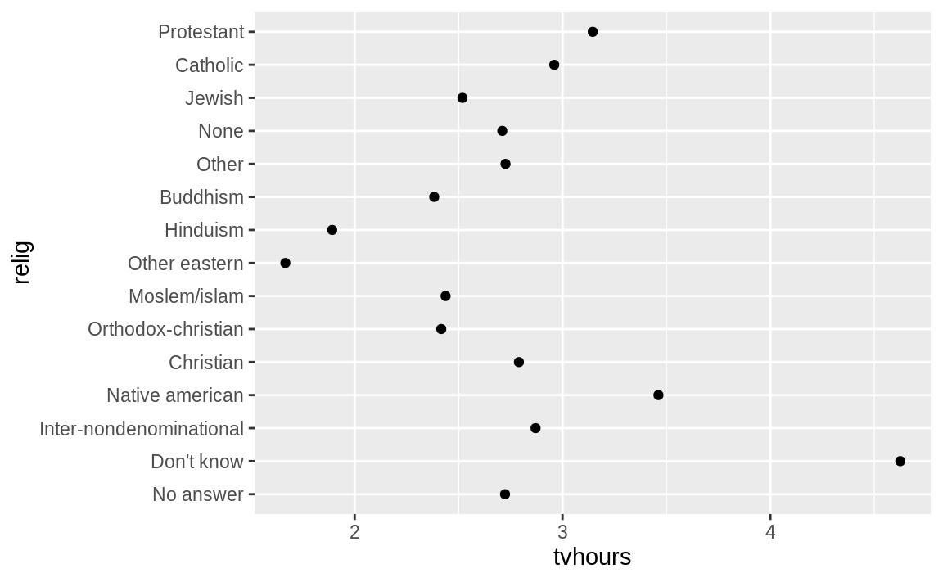
Modifying factor order
Notes:
It is difficult to interpret this plot because there’s no overall pattern. We can improve it by reordering the levels of relig using fct_reorder(). fct_reorder() takes three arguments:

Slide 16
fct_reorder()
f, the factor whose levels you want to modify.
x, a numeric vector that you want to use to reorder the levels.
Optionally, fun, a function that’s used if there are multiple values of x for each value of f. The default value is median.
Notes:
f, the factor whose levels you want to modify.
x, a numeric vector that you want to use to reorder the levels.
Optionally, fun, a function that’s used if there are multiple values of x for each value of f. The default value is median.

Slide 17
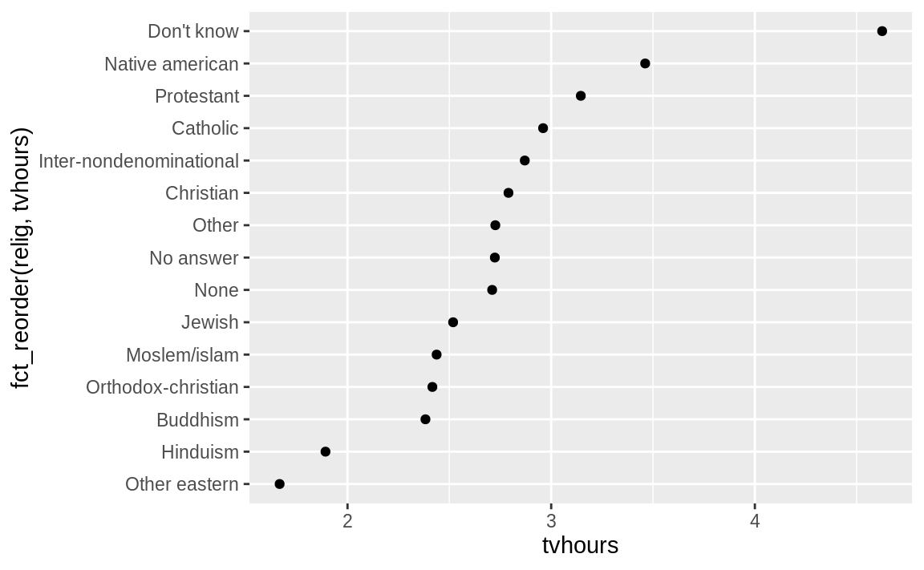
Modifying factor order
ggplot(relig_summary, aes(tvhours, fct_reorder(relig, tvhours))) +
geom_point()
Notes:
Reordering religion makes it much easier to see that people in the “Don’t know” category watch much more TV, and Hinduism & Other Eastern religions watch much less.

Slide 18
moving out of aes()
relig_summary %>%
mutate(relig = fct_reorder(relig, tvhours)) %>%
ggplot(aes(tvhours, relig)) +
geom_point()
Notes:
As you start making more complicated transformations, I’d recommend moving them out of aes() and into a separate mutate() step. For example, you could rewrite the plot above as:

Slide 19
average age and income
rincome_summary <- gss_cat %>%
group_by(rincome) %>%
summarise(
age = mean(age, na.rm = TRUE),
tvhours = mean(tvhours, na.rm = TRUE),
n = n() )
ggplot(rincome_summary, aes(age, fct_reorder(rincome, age))) +
geom_point()
Notes:
What if we create a similar plot looking at how average age varies across reported income level?

Slide 20
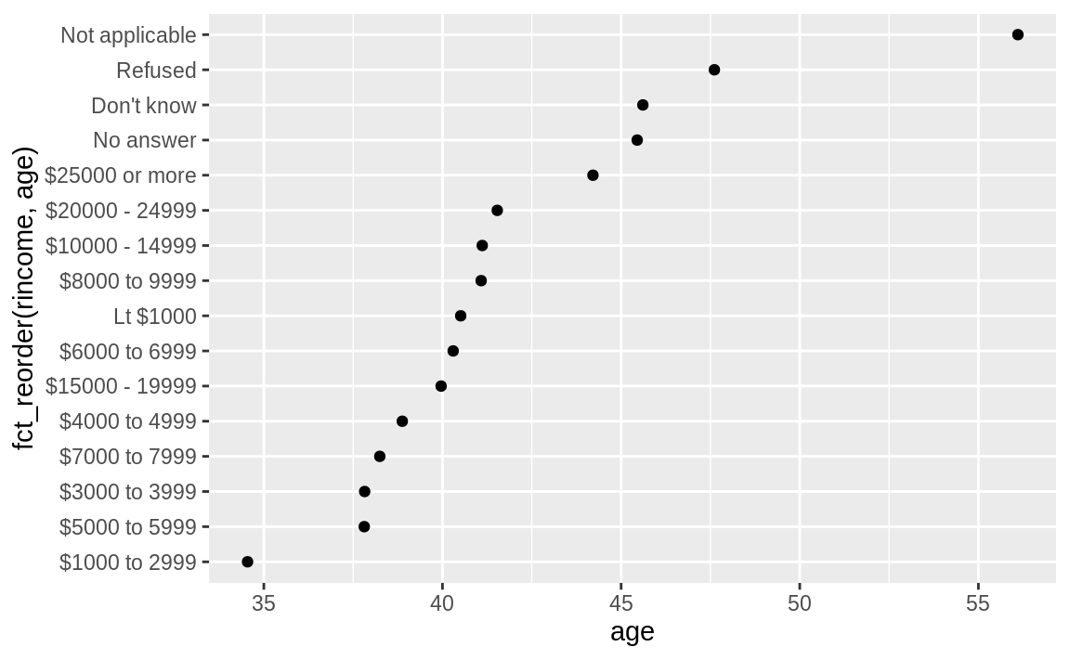
average age and income
Notes:
Here, arbitrarily reordering the levels isn’t a good idea! That’s because rincome already has a principled order that we shouldn’t mess with. Reserve fct_reorder() for factors whose levels are arbitrarily ordered.

Slide 21
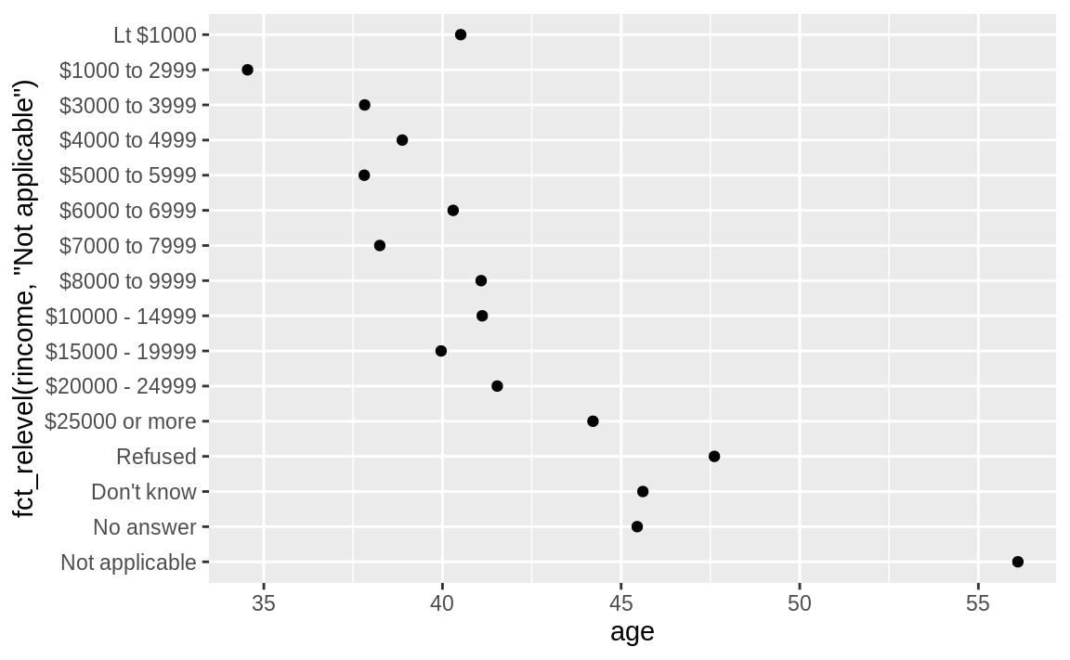
fct_relevel()
ggplot(rincome_summary, aes(age, fct_relevel(rincome, "Not applicable"))) +
geom_point()
Notes:
However, it does make sense to pull “Not applicable” to the front with the other special levels. You can use fct_relevel(). It takes a factor, f, and then any number of levels that you want to move to the front of the line.
Why do you think the average age for “Not applicable” is so high?

Slide 22
fct_reorder2()
by_age <- gss_cat %>%
filter(!is.na(age)) %>%
count(age, marital) %>%
group_by(age) %>%
mutate(prop = n / sum(n))
ggplot(by_age, aes(age, prop, color = marital)) +
geom_line(na.rm = TRUE)
ggplot(by_age, aes(age, prop, color = fct_reorder2(marital, age, prop))) +
geom_line() + labs(color = "marital")
Notes:
Another type of reordering is useful when you are coloring the lines on a plot. fct_reorder2() reorders the factor by the y values associated with the largest x values.

Slide 23
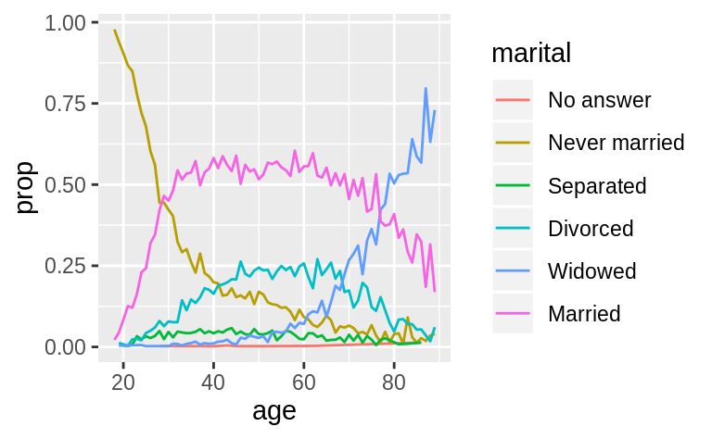
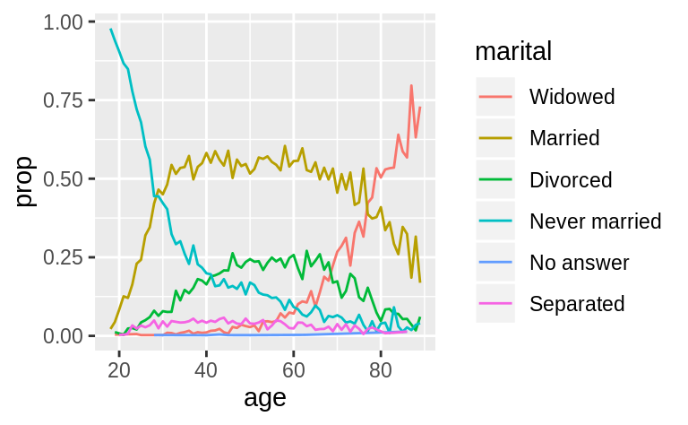
fct_reorder2()
Notes:
This makes the plot easier to read because the line colours line up with the legend.

Slide 24
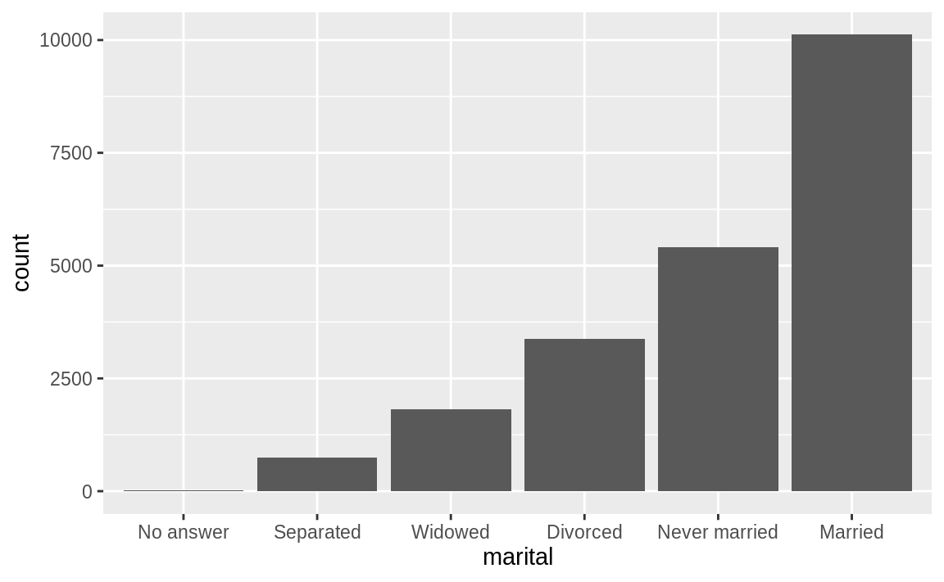
fct_infreq()
gss_cat %>%
mutate(marital = marital %>%
fct_infreq() %>%
fct_rev()) %>%
ggplot(aes(marital)) +
geom_bar()
Notes:
Finally, for bar plots, you can use fct_infreq() to order levels in increasing frequency: this is the simplest type of reordering because it doesn’t need any extra variables. You may want to combine with fct_rev().

Slide 25
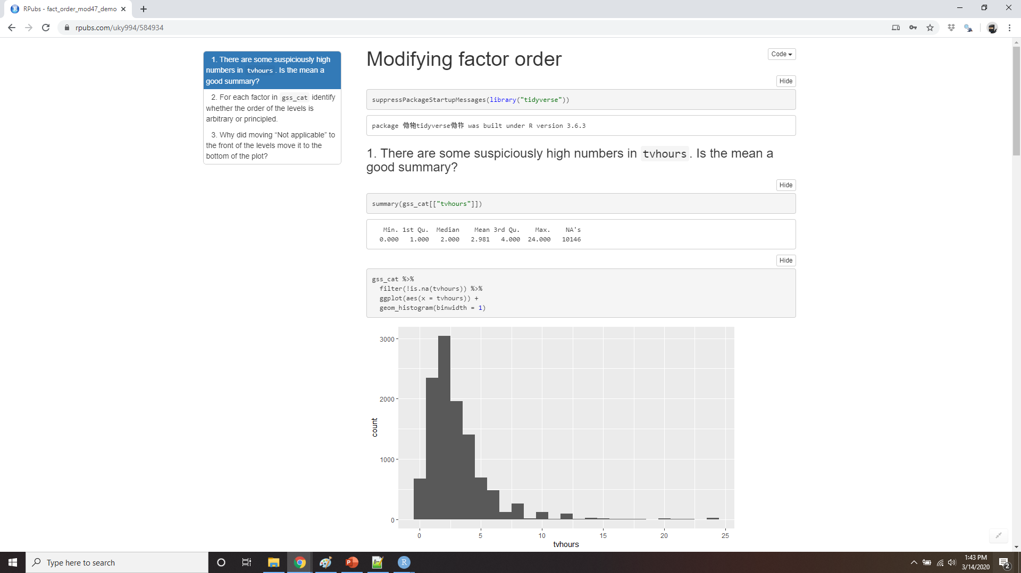
Demo modifying factor order
Notes:
https://rpubs.com/uky994/584934
There are some suspiciously high numbers in tvhours. Is the mean a good summary?
For each factor in gss_cat identify whether the order of the levels is arbitrary or principled.
Why did moving “Not applicable” to the front of the levels move it to the bottom of the plot?

Slide 26
Modifying factor levels
gss_cat %>% count(partyid)
#> # A tibble: 10 x 2
#> partyid n
#> <fct> <int>
#> 1 No answer 154
#> 2 Don't know 1
#> 3 Other party 393
#> 4 Strong republican 2314
#> 5 Not str republican 3032
#> 6 Ind,near rep 1791
#> # … with 4 more rows
Notes:
More powerful than changing the orders of the levels is changing their values. This allows you to clarify labels for publication, and collapse levels for high-level displays. The most general and powerful tool is fct_recode(). It allows you to recode, or change, the value of each level. For example, take the gss_cat$partyid:

Slide 27
Fct_recode()
gss_cat %>%
mutate(partyid = fct_recode(partyid,
"Republican, strong" = "Strong republican",
"Republican, weak" = "Not str republican",
"Independent, near rep" = "Ind,near rep",
"Independent, near dem" = "Ind,near dem",
"Democrat, weak" = "Not str democrat",
"Democrat, strong" = "Strong democrat" )) %>%
count(partyid)
#> # A tibble: 10 x 2
#> partyid n
#> <fct> <int>
#> 1 No answer 154
#> 2 Don't know 1
#> 3 Other party 393
#> 4 Republican, strong 2314
#> # … with 6 more rows
Notes:
The levels are terse and inconsistent. Let’s tweak them to be longer and use a parallel construction.
fct_recode() will leave levels that aren’t explicitly mentioned as is, and will warn you if you accidentally refer to a level that doesn’t exist.

Slide 28
Reassign multiple old levels
gss_cat %>%
mutate(partyid = fct_recode(partyid,
"Republican, strong" = "Strong republican",
"Republican, weak" = "Not str republican",
"Independent, near rep" = "Ind,near rep",
"Independent, near dem" = "Ind,near dem",
"Democrat, weak" = "Not str democrat",
"Democrat, strong" = "Strong democrat",
"Other" = "No answer",
"Other" = "Don't know",
"Other" = "Other party" )) %>%
count(partyid)
#> # A tibble: 8 x 2
#> partyid n
#> <fct> <int>
#> 1 Other 548
#> 2 Republican, strong 2314
#> # … with 6 more rows
Notes:
To combine groups, you can assign multiple old levels to the same new level:
You must use this technique with care: if you group together categories that are truly different you will end up with misleading results.

Slide 29
fct_collapse()
gss_cat %>%
mutate(partyid = fct_collapse(partyid,
other = c("No answer", "Don't know", "Other party"),
rep = c("Strong republican", "Not str republican"),
ind = c("Ind,near rep", "Independent", "Ind,near dem"),
dem = c("Not str democrat", "Strong democrat") )) %>%
count(partyid)
#> # A tibble: 4 x 2
#> partyid n
#> <fct> <int>
#> 1 other 548
#> 2 rep 5346
#> 3 ind 8409
#> 4 dem 7180
Notes:
If you want to collapse a lot of levels, fct_collapse() is a useful variant of fct_recode(). For each new variable, you can provide a vector of old levels:

Slide 30
Fct_lump()
gss_cat %>%
mutate(relig = fct_lump(relig)) %>%
count(relig)
#> # A tibble: 2 x 2
#> relig n
#> <fct> <int>
#> 1 Protestant 10846
#> 2 Other 10637
Notes:
Sometimes you just want to lump together all the small groups to make a plot or table simpler. That’s the job of fct_lump():
The default behaviour is to progressively lump together the smallest groups, ensuring that the aggregate is still the smallest group. In this case it’s not very helpful: it is true that the majority of Americans in this survey are Protestant, but we’ve probably over collapsed.

Slide 31
N=
gss_cat %>%
mutate(relig = fct_lump(relig, n = 10)) %>%
count(relig, sort = TRUE) %>%
print(n = Inf)
#> # A tibble: 10 x 2
#> relig n
#> <fct> <int>
#> 1 Protestant 10846
#> 2 Catholic 5124
#> 3 None 3523
#> 4 Christian 689
#> 5 Other 458
#> 6 Jewish 388
#> 7 Buddhism 147
#> 8 Inter-nondenominational 109
#> 9 Moslem/islam 104
#> 10 Orthodox-christian 95
Notes:
Instead, we can use the n parameter to specify how many groups (excluding other) we want to keep:

Slide 32
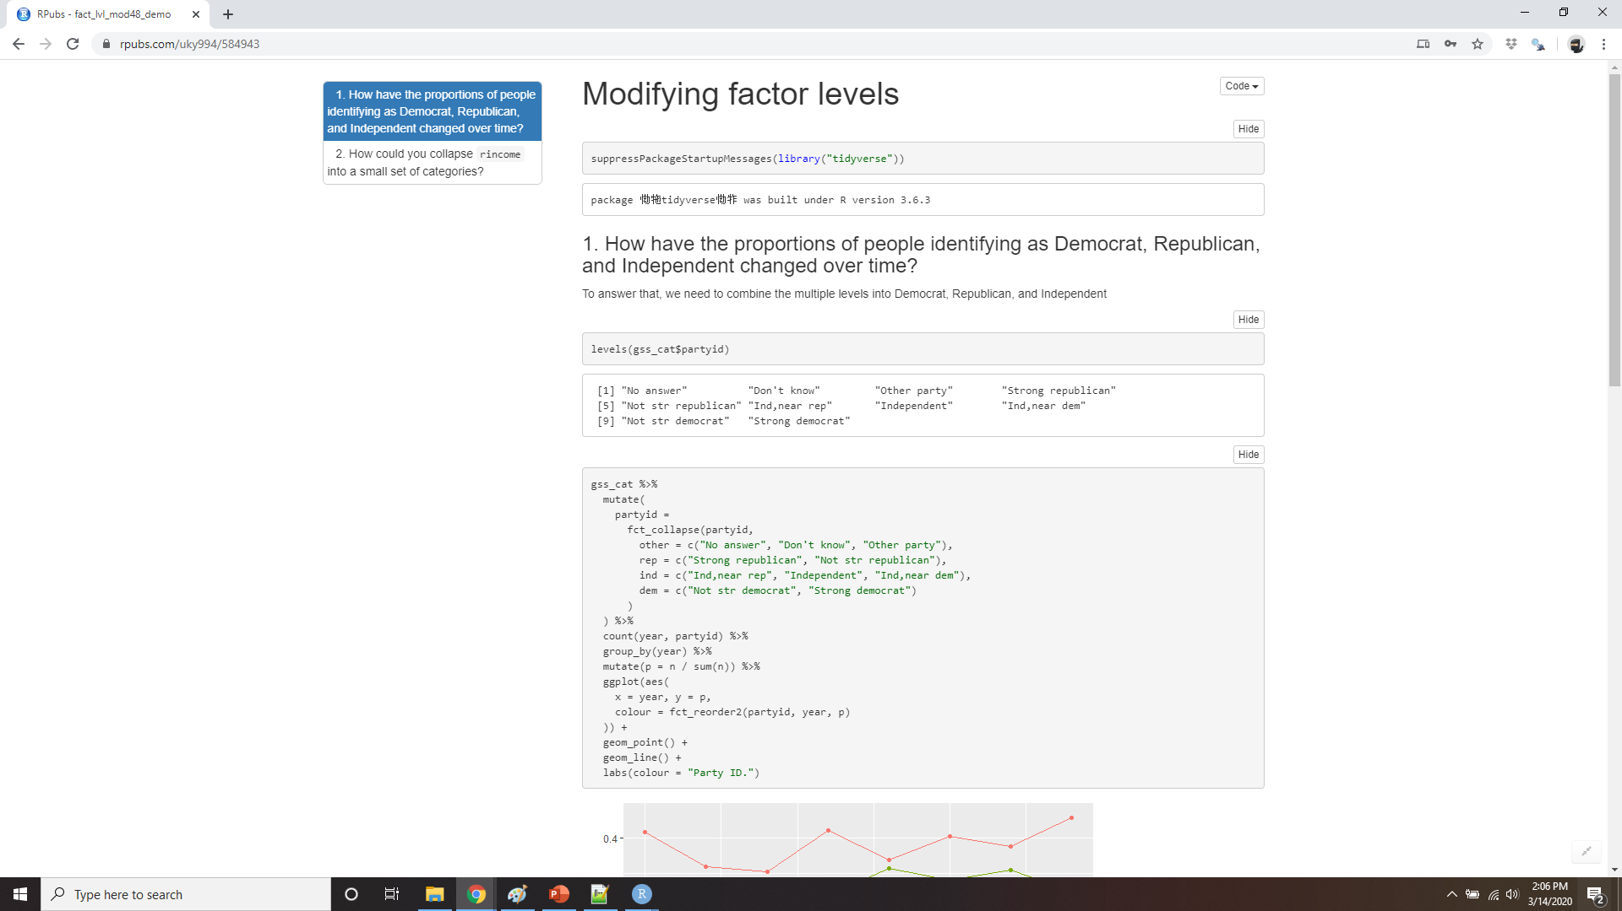
Demo modifying factor levels
Notes:
https://rpubs.com/uky994/584943
How have the proportions of people identifying as Democrat, Republican, and Independent changed over time?
How could you collapse rincome into a small set of categories?

